Slide 1

LearnHub: Your Collaborative Learning Platform

Slide 2

Introduction to LearnHub
LearnHub is an innovative platform designed to foster a dynamic and interactive learning environment. We aim to solve the challenges of fragmented online education by providing a centralized hub for course management, communication, and resource sharing.

Slide 3
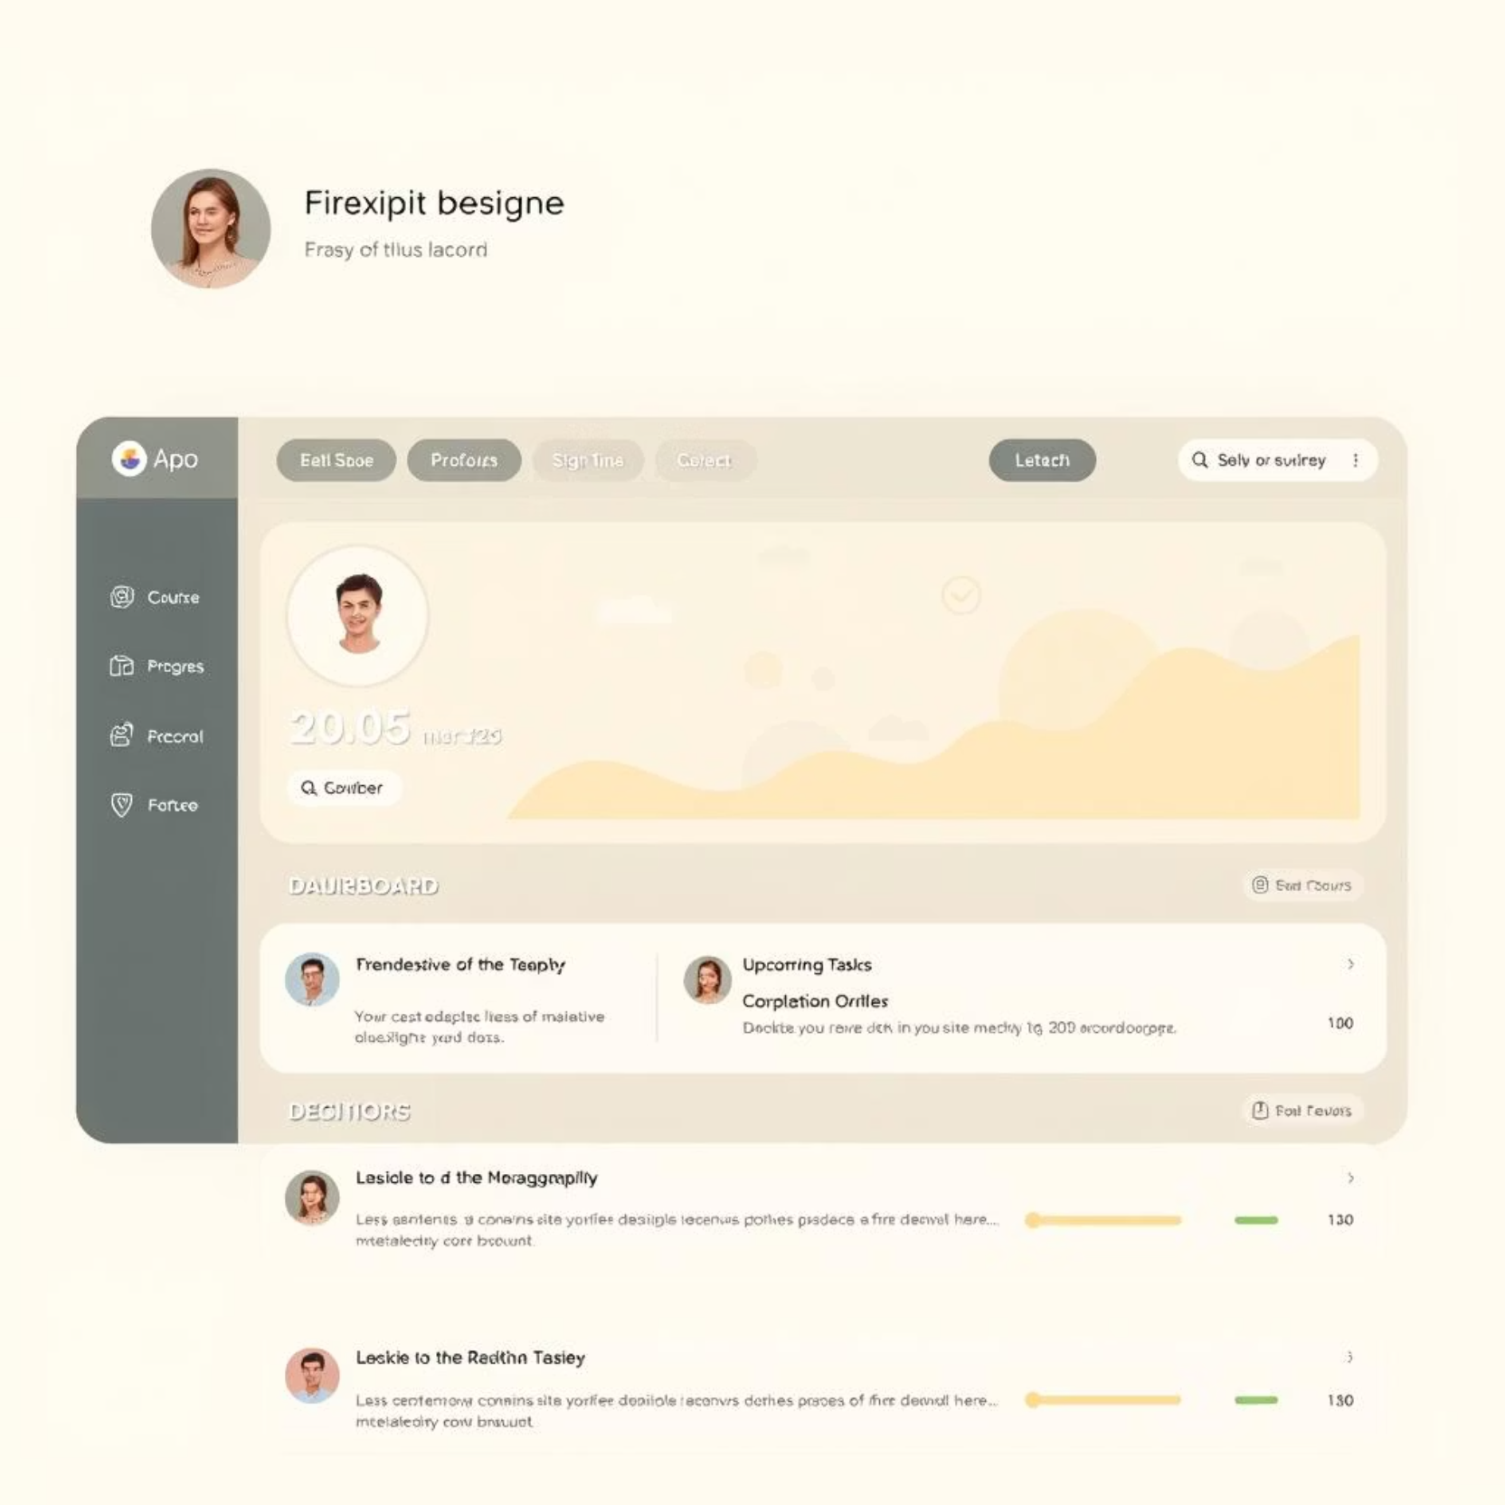
Key Features Overview
Comprehensive Course Management
Easily create, manage, and organize course content, assignments, and deadlines.
Secure User Authentication
Robust login and registration system ensuring data privacy and secure access.
Interactive Discussion Forums
Engage in vibrant discussions, ask questions, and collaborate with peers and instructors.

Slide 4




Technical Foundations
LearnHub is built on a robust and scalable architecture, utilizing cutting-edge technologies to ensure performance and reliability.
Programming Languages
Developed with modern JavaScript and Python for efficiency and versatility.
Database Management
Data stored securely and efficiently using PostgreSQL for relational data and MongoDB for flexible document storage.
Cloud Deployment
Hosted on Vercel for fast, scalable deployment and seamless user experience.

Slide 5




Transformative Benefits for Users
LearnHub enhances the educational experience for both students and instructors, addressing common pain points in online learning.
For Students
Improved access to course materials, enhanced collaboration, and a more engaging learning journey.
For Instructors
Streamlined course administration, efficient communication tools, and powerful analytics for student progress tracking.
For Institutions
Centralized platform for all online learning activities, reducing administrative overhead and improving educational outcomes.

Slide 6
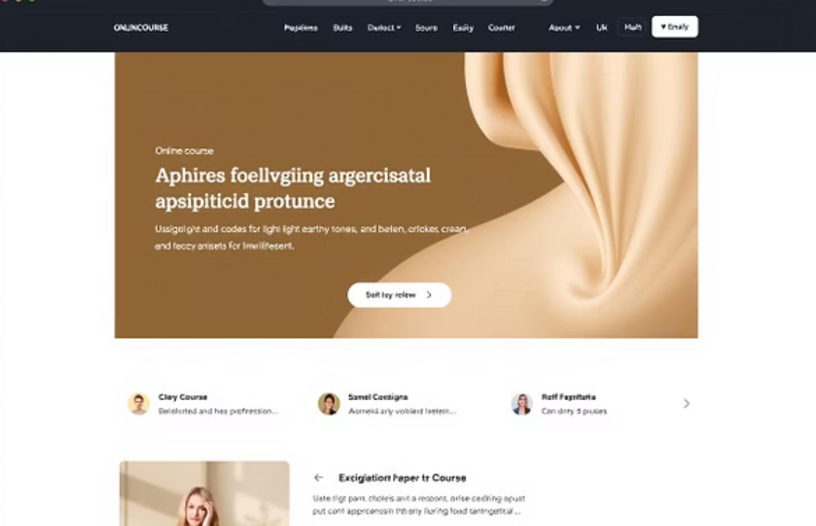
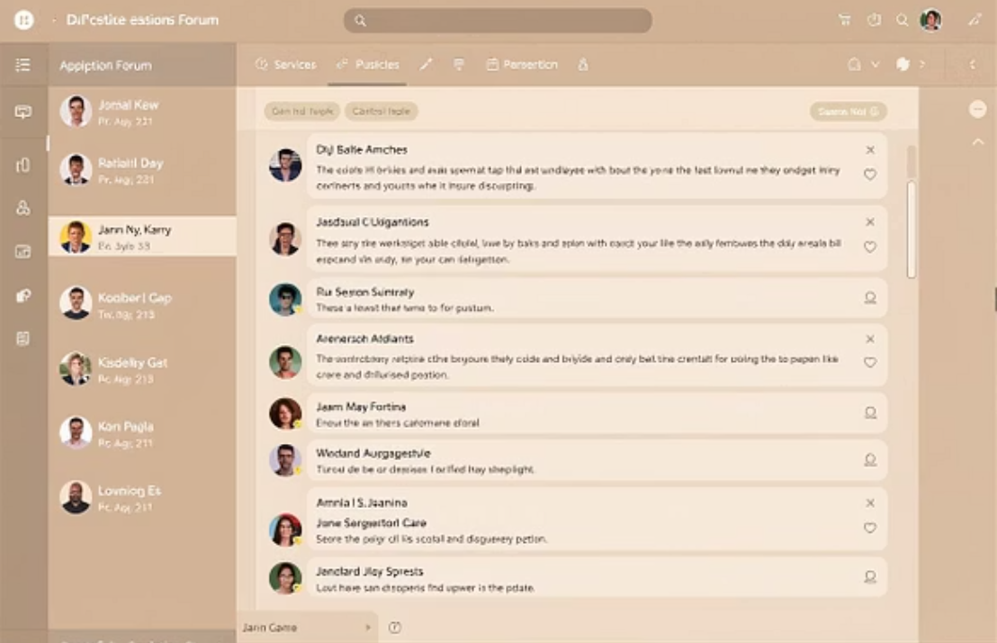
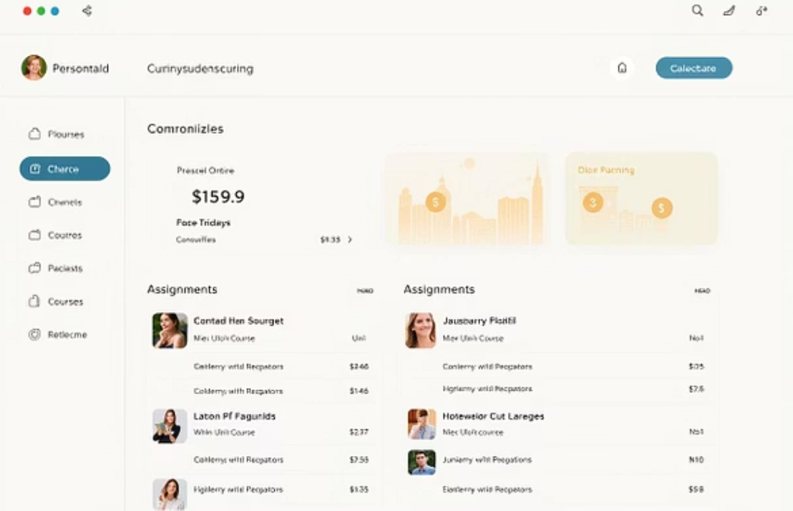
Intuitive User Interface
Our user interface is designed for simplicity and accessibility, ensuring a smooth and engaging experience for all users.

Slide 7


Challenges & Solutions
Developing LearnHub presented unique challenges, but we successfully implemented innovative solutions to overcome them.
Scalability Issues
Integration Complexities
As user numbers grew, ensuring the platform could handle increased traffic and data became critical. Our solution involved implementing load balancing and optimizing database queries for improved performance.
Integrating various third-party services and APIs proved complex. We tackled this by designing a modular architecture with clear API contracts, allowing for seamless communication and data exchange.

Slide 8




Future Development & Vision
LearnHub is continuously evolving. Our future plans focus on enhancing user experience, expanding features, and exploring new technologies.
1
AI-Powered Learning Paths
2
Enhanced Mobile Experience
3
Gamification & Badges
4
Offline Access to Content

Slide 9
Thank You for Your Interest
We are truly grateful for your time and attention to LearnHub's vision.
Our Team
Chilukuri Sri Lakshmi
Bhargav Dokala
Chintalapati Vamsikrishna
Madanaboyana Sai Saranya

